Slide 1
NO Oxidation on Pt/Al₂O₃: Kinetics study¹ ^{Prepared by: Niamul Hassan} ^{#ID 116455129} Chemical and Molecular Engineering ^{Stony Brook University}

Slide 2
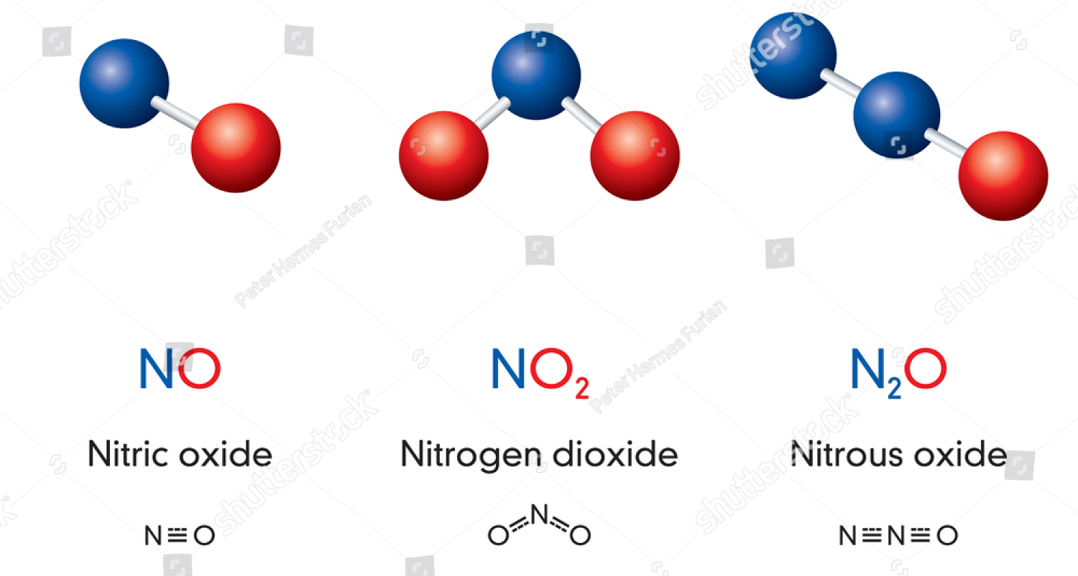
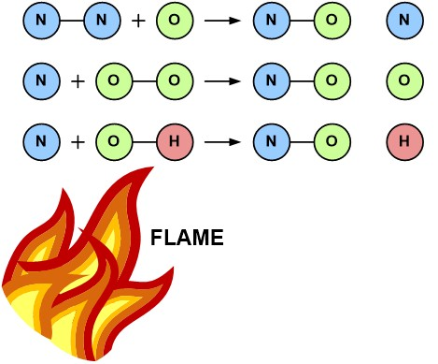
Background
NO_{x}
NO_{x} mainly consists of NO and smaller amount of NO₂
At high temperature inside internal combustion (IC) engine, NO_{x} forms from N₂ and O₂ of air above 1500℃
It increases with temperature.
N₂ containing fuel additives also produce NO_{x} during combustion.
Courtesy: Shutterstock.
Courtesy: Fossil consulting services
Notes:
NO_{x} is shorthand for nitric oxide (NO) and nitrogen dioxide (NO₂)
produced from the reaction between nitrogen and oxygen during combustion of fuels, such as hydrocarbons, in air; especially at high temperatures, such as in car engines

Slide 3
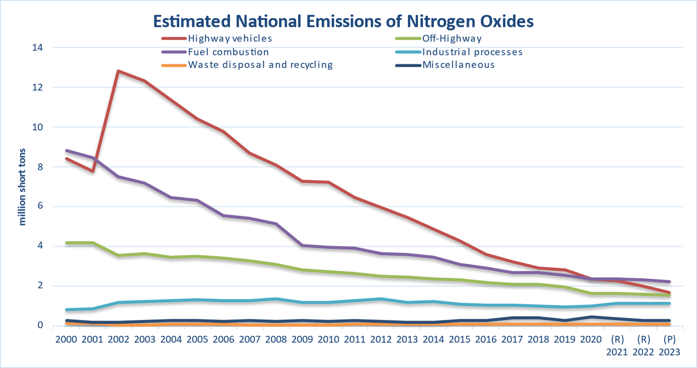
Background
Health concerns
Respiratory exposure causes asthma.
Exacerbates Non-respiratory diseases.
Forms ozone that damages lungs tissue
Environmental concerns
Greenhouse effect
EPA imposes regulations on NO_{x} emission from IC engines.
Study of NO_{x} abatement is important.
Figure: National emissions of NO_{x} from various sources².

Slide 4
Experimental: Synthesis
Catalyst: 0.3wt% Pt/Al₂O₃
Fresh catalyst: As-synthesized, 42% Pt dispersion
Sintered catalyst: calcined at 600C for 6h in dry air
It lowers the Pt dispersion.
Agglomeration.

Slide 5
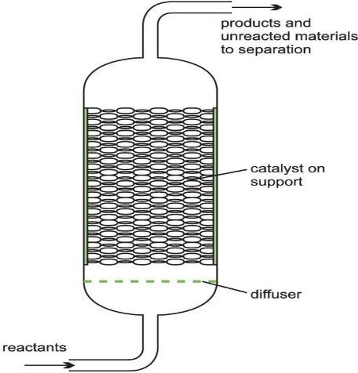
Experimental: Reaction set-up
Stainless-steel packed-bed reactor.
Catalyst was wrapped in insulation to minimize bypassing of gas.
The reactor was installed into a furnace with a thermocouple.
Inlet gas was pre-heated by a separate heating furnace.
Figure: A packed-bed reactor (PBR).

Slide 6
Experimental: Kinetics Measurement
NO conversion < 15% to operate as differential reactor.
Data was collected after 1 hr. to ensure steady state.
Sintered sample
To check reaction order, the concentrations of NO, O₂ , and NO₂ were changed 80-480 ppm, 10-25%, and 100-240 ppm one-at-a-time, respectively.
Fresh sample
Like sintered one, reaction order was checked.

Slide 7
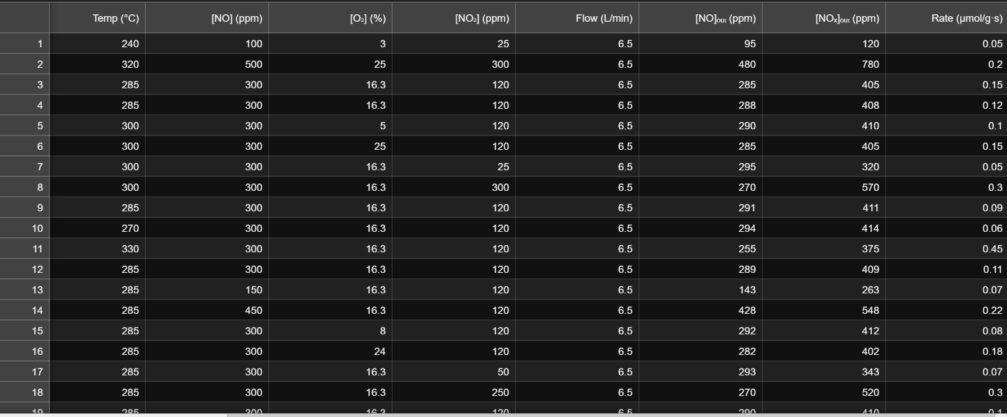
Experimental: Kinetics Measurement
Figure: Experimental data for fresh Pt/Al₂O₃ sample.
Notes:
There are lots of data, however, we do not need all of them.

Slide 8
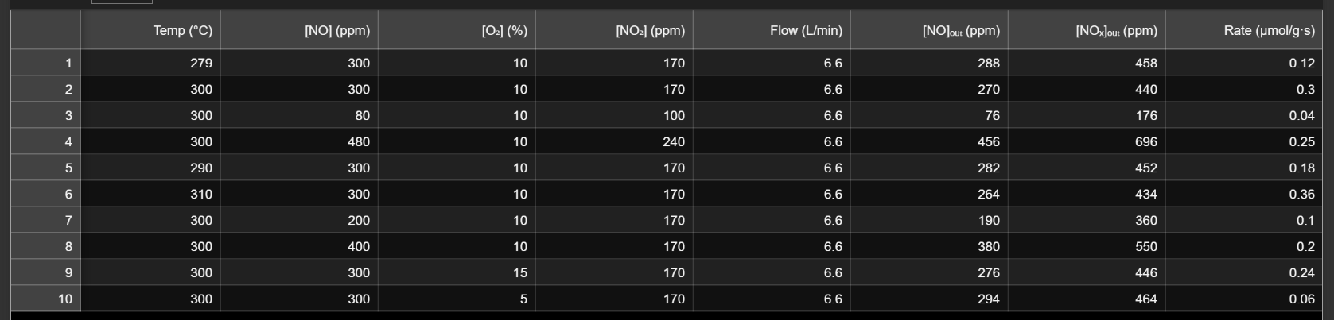
Experimental: Kinetics Measurement
Figure: Experimental data for sintered Pt/Al₂O₃ sample.
Notes:
With this data set, first easiest thing that we can calculate is the conversion of NO.

Slide 9
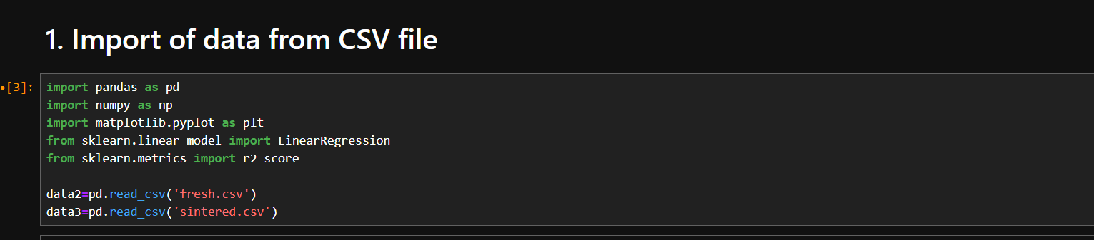
Application of Python: Importing CSV files
Experimental data were imported from two CSV files (fresh and sintered) using pd.read_csv.
A CSV file is easier to handle in python.
Notes:
For that purpose, experimental dataset were imported from two CSV files using panda.read_csv.

Slide 10
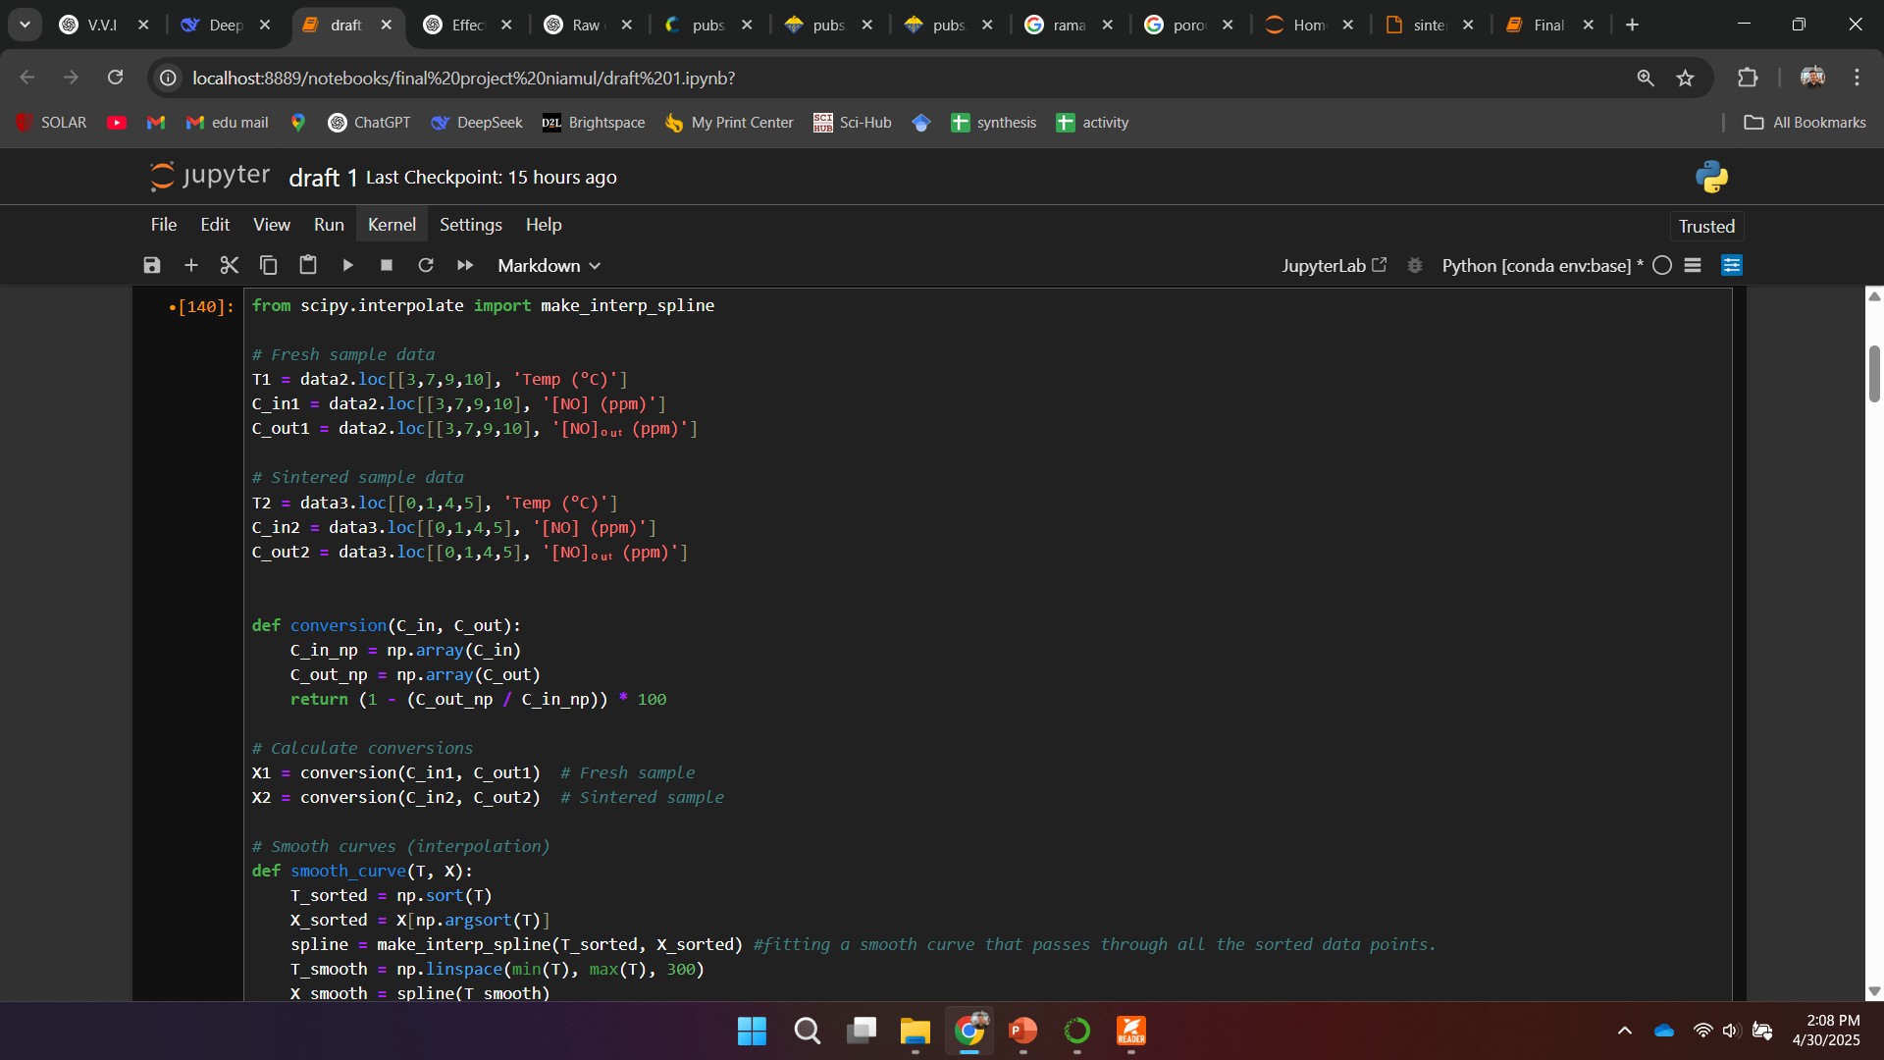
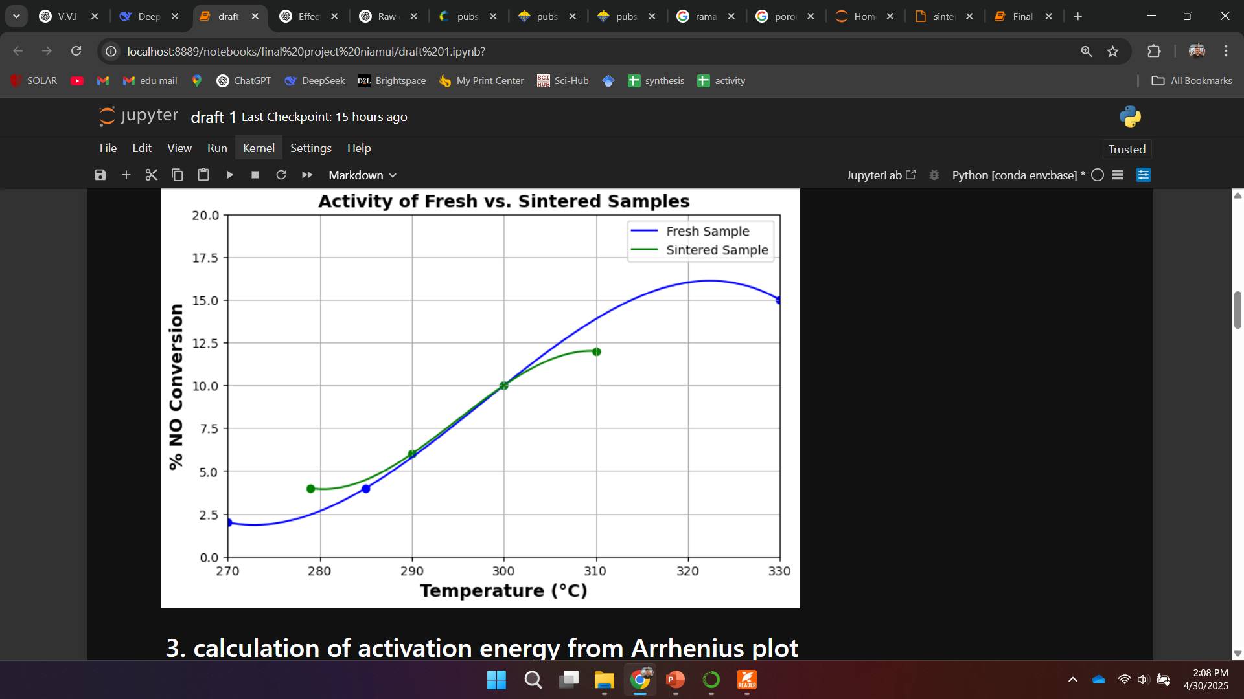
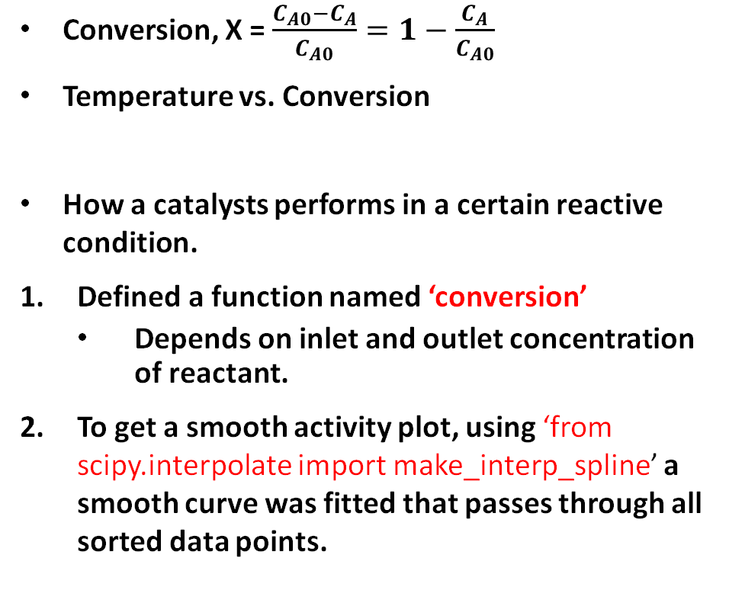
Application of Python: Activity plot
Conversion, X = $\frac{C_{A0}−C_{A}}{C_{A0}}=1−\frac{C_{A}}{C_{A0}}$
Temperature vs. Conversion
How a catalysts performs in a certain reactive condition.
Defined a function named ‘conversion’
Depends on inlet and outlet concentration of reactant.
To get a smooth activity plot, using ‘from scipy.interpolate import make_interp_spline’ a smooth curve was fitted that passes through all sorted data points.
Notes:
Defined a function named ‘Conversion’ that takes inlet and outlet concentration as input.
I expressed the conversion as percentage.
Smooth_curve fcn: This function takes two sets of data points (T and X) and creates a smooth curve between points.
make_interp_spline: fitting a smooth curve that passes through all the sorted data points.

Slide 11
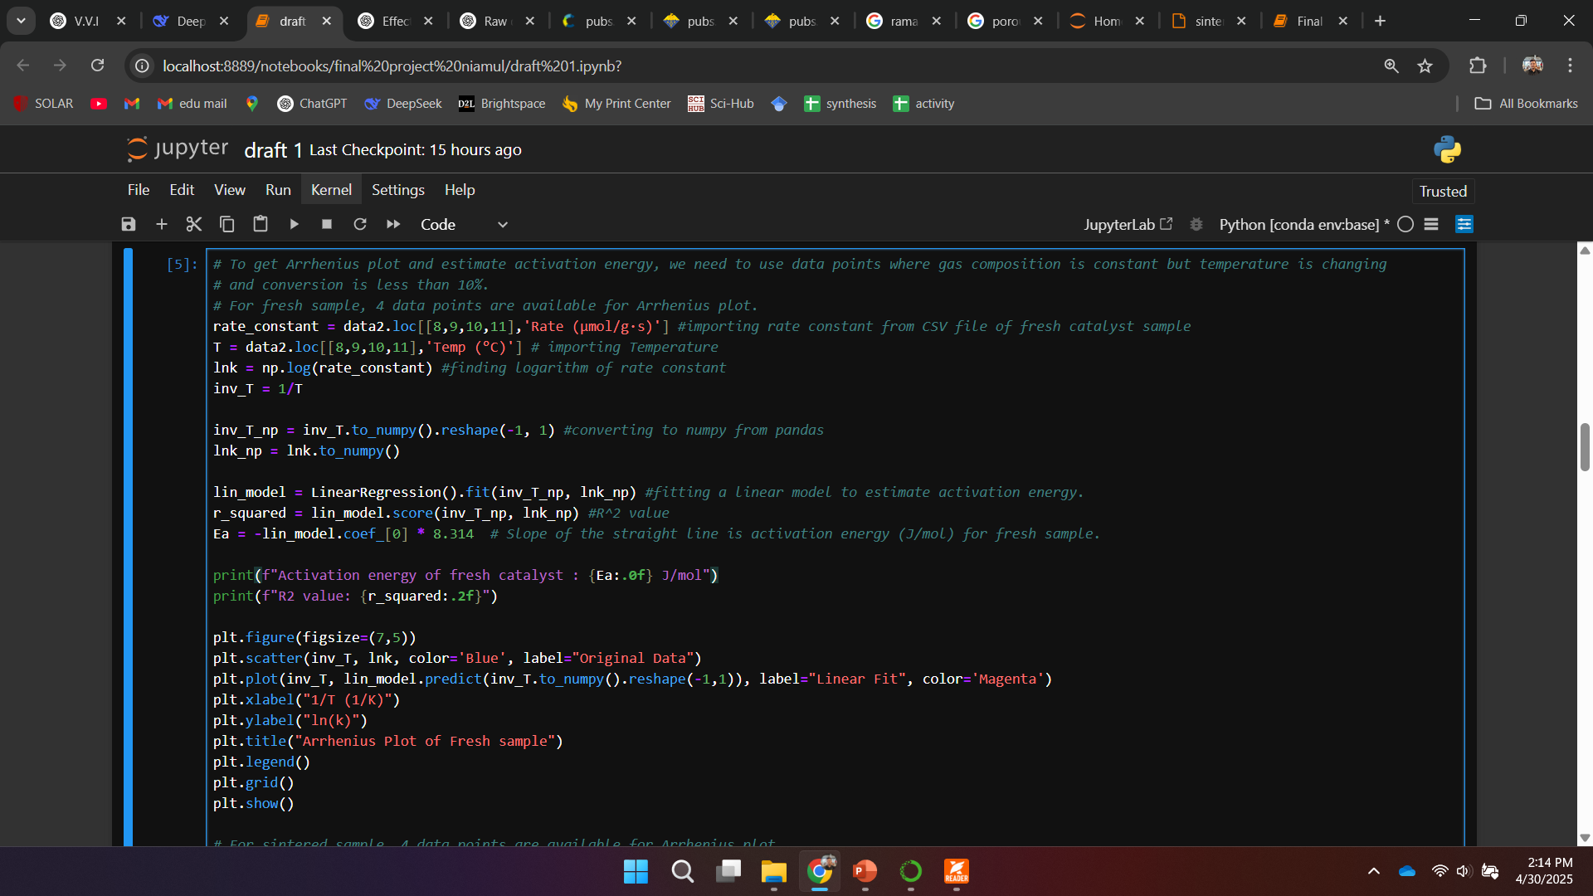
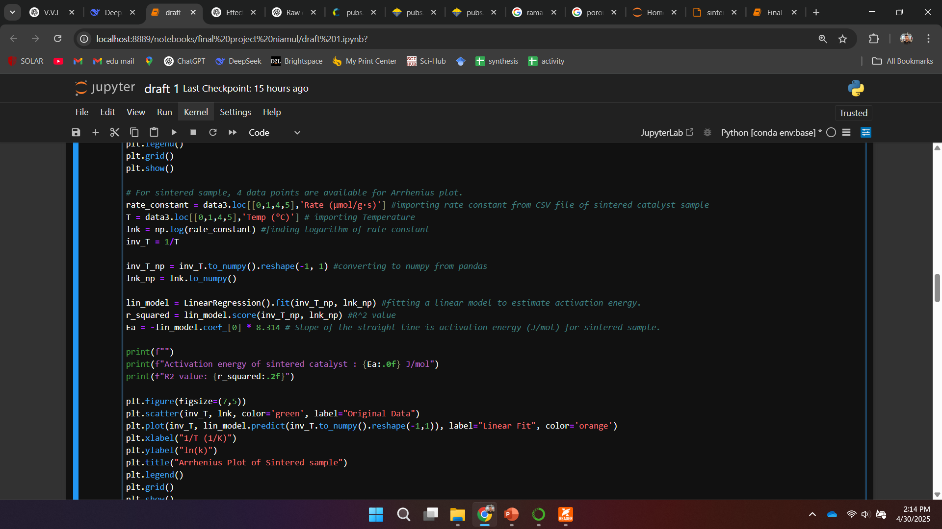
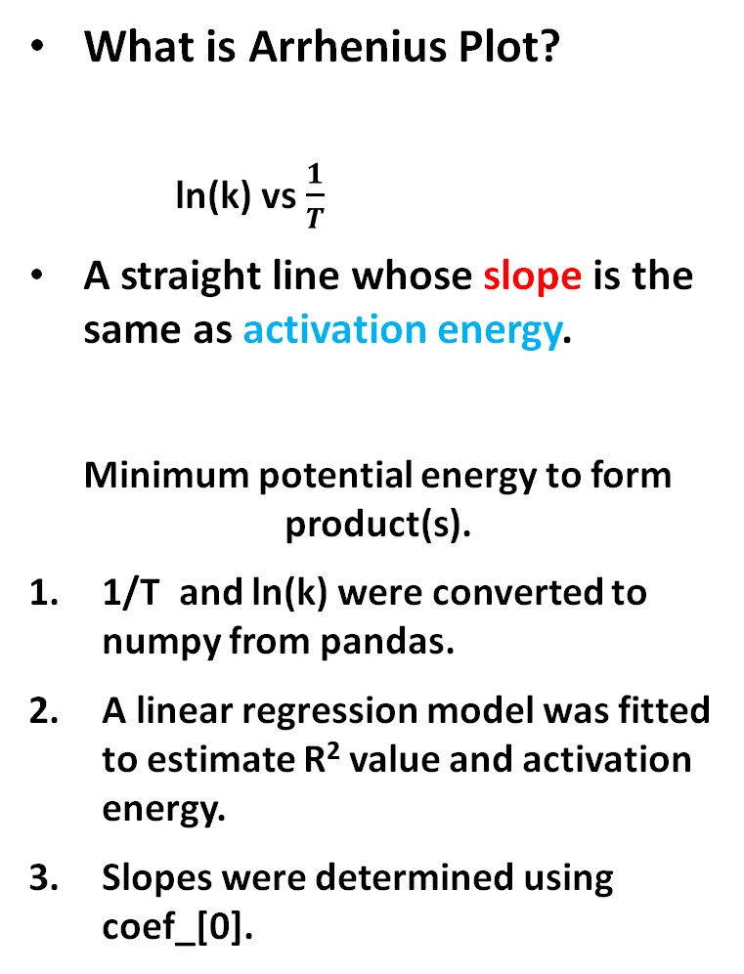
Application of Python: Arrhenius plot
What is Arrhenius Plot?
ln(k) vs $\frac{1}{T}$
A straight line whose slope is the same as activation energy.
Minimum potential energy to form product(s).
1/T and ln(k) were converted to numpy from pandas.
A linear regression model was fitted to estimate R² value and activation energy.
Slopes were determined using coef_[0].
Fresh
Sintered
Notes:
To get Arrhenius plot and estimate activation energy, we need to use data points where gas composition is constant, but temperature is changing, and conversion is less than 10%.
For fresh sample, 4 data points are available for Arrhenius plot.
For sintered sample, also 4 data points are available for Arrhenius plot.
1/T, ln(k) were converted to numpy arrays from pandas series.

Slide 12
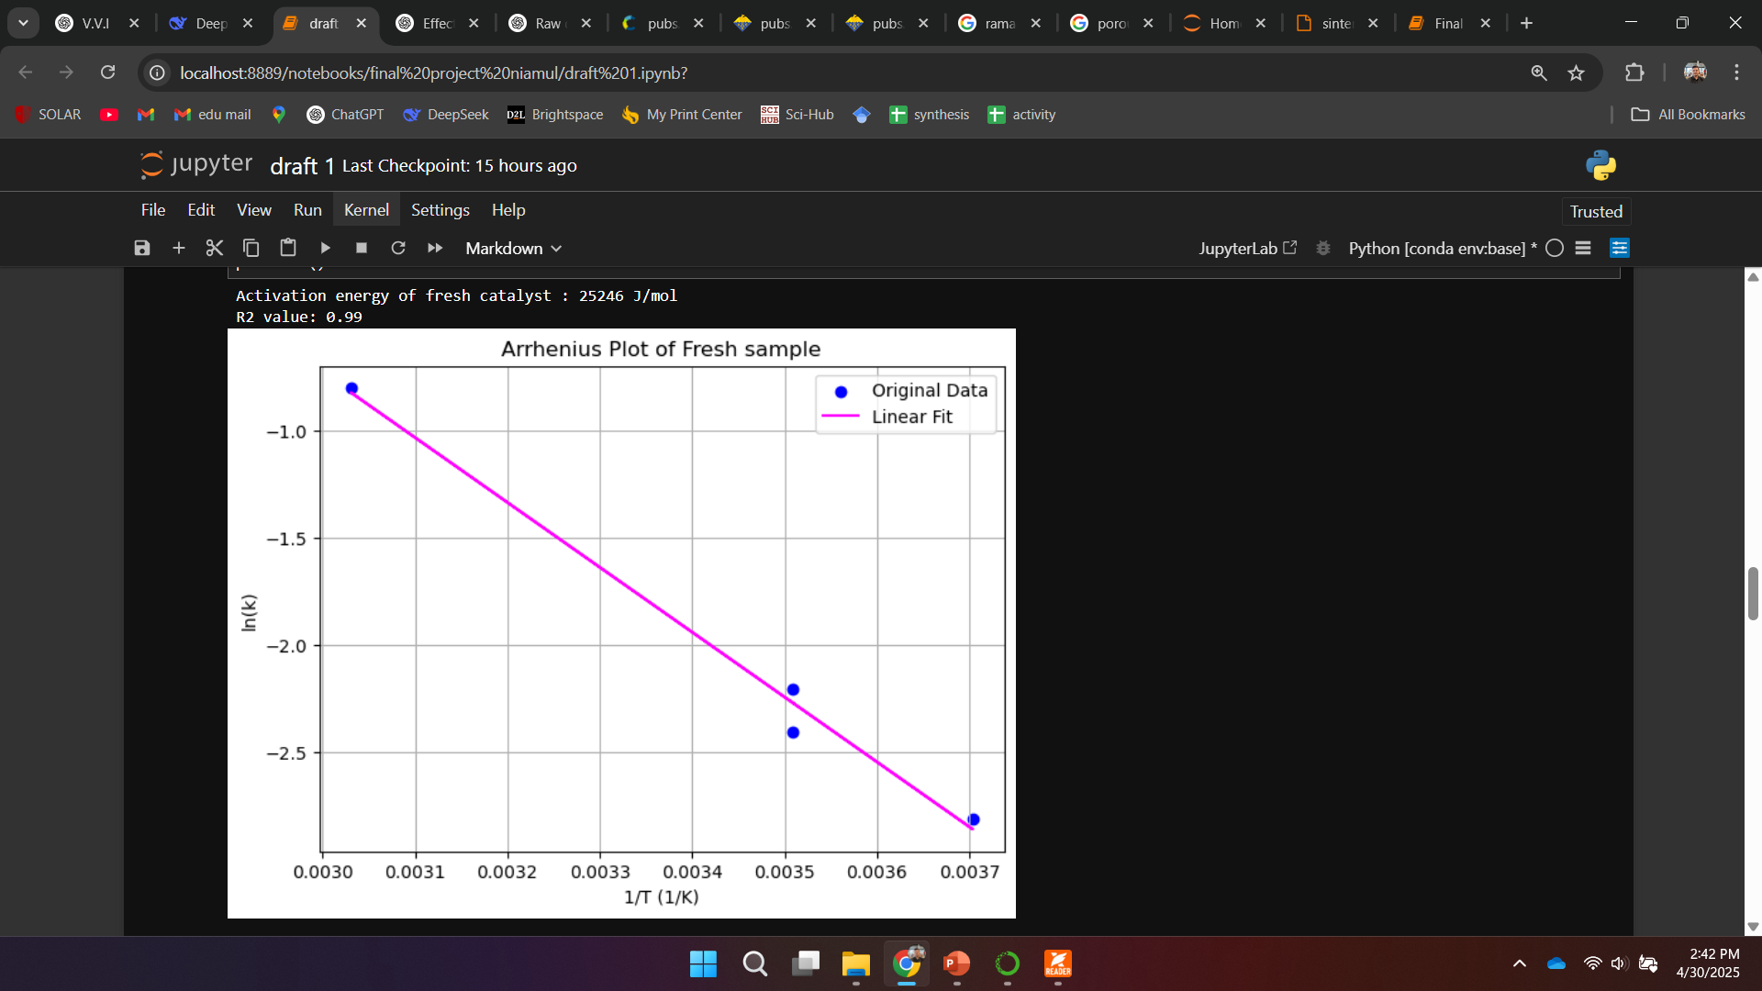
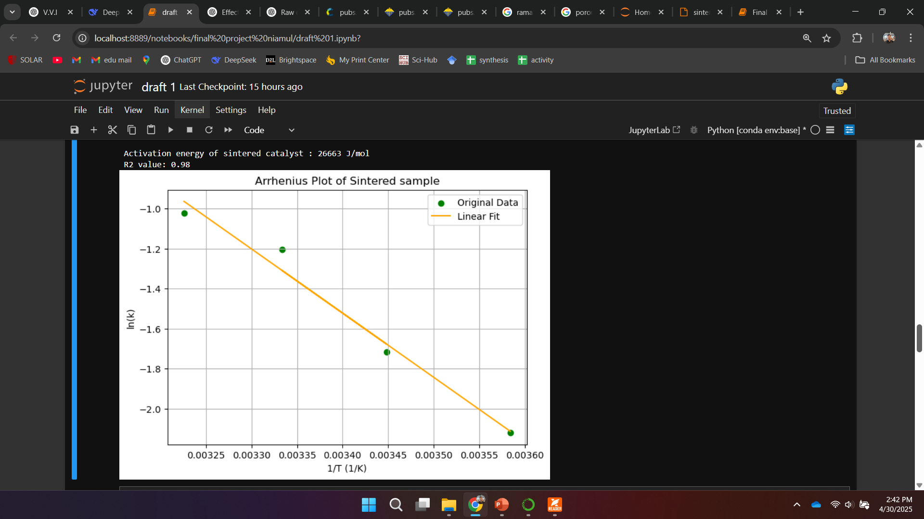
Application of Python: Arrhenius plot
Arrhenius Plots of Both fresh and sintered samples.
Notes:
Ea of sintered sample is higher than the fresh one.
It was the expected outcome, because when fresh sample was heated at 600C for 6h, its morphology is changed.
Crystalline size goes up, agglomeration occurs, surface area decreases which reduces the activity.

Slide 13
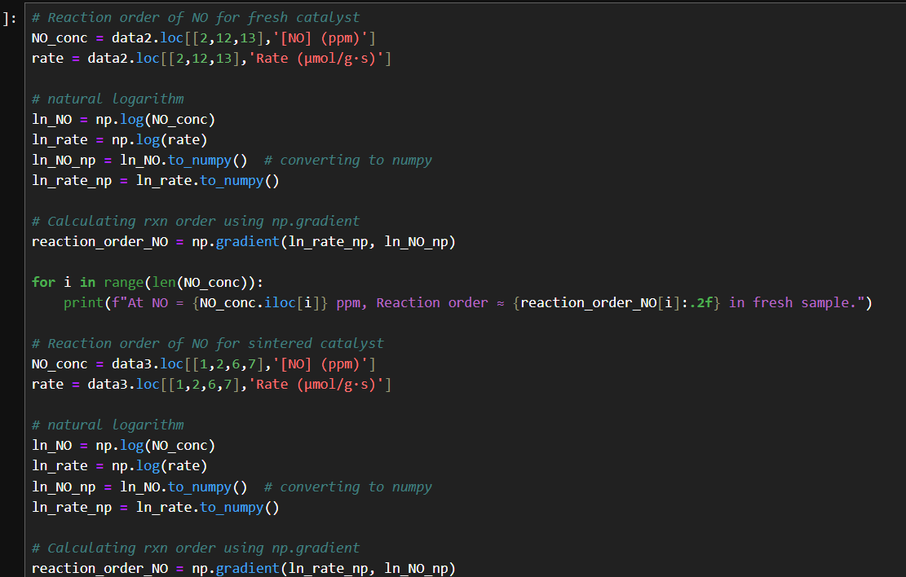
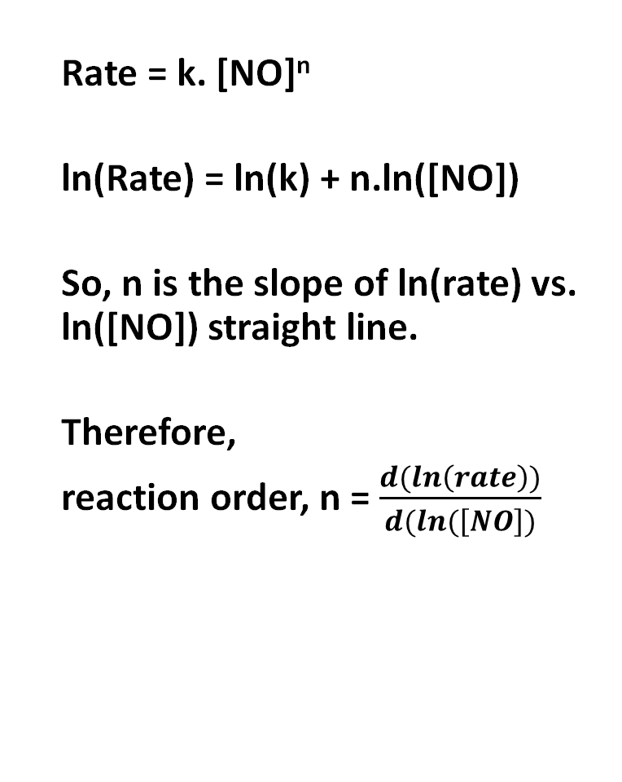
Application of Python: Reaction order
Rate = k. [NO]^{n}
ln(Rate) = ln(k) + n.ln([NO])
So, n is the slope of ln(rate) vs. ln([NO]) straight line.
Therefore,
reaction order, n = $\frac{d(ln\left(rate\right))}{d(ln(\left[NO\right])}$
Reaction order of NO for fresh and sintered samples.
Notes:
1. first, [NO] and rxn rate were extracted from CSV files.
2. Their natural log was calculated using np.log and converted into numpy arrays from pandas series.
3. Slope was estimated using np.gradient

Slide 14
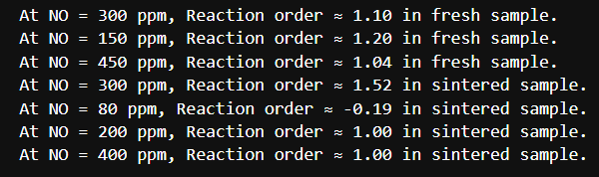
Application of Python: Reaction order
Concentration and corresponding reaction rate were imported from CSV.
Natural logarithm were calculated using np.log
Pandas series were converted into numpy array.
Estimation or rxn order using np.gradient
Output:
Reaction order of NO for fresh and sintered samples.

Slide 15
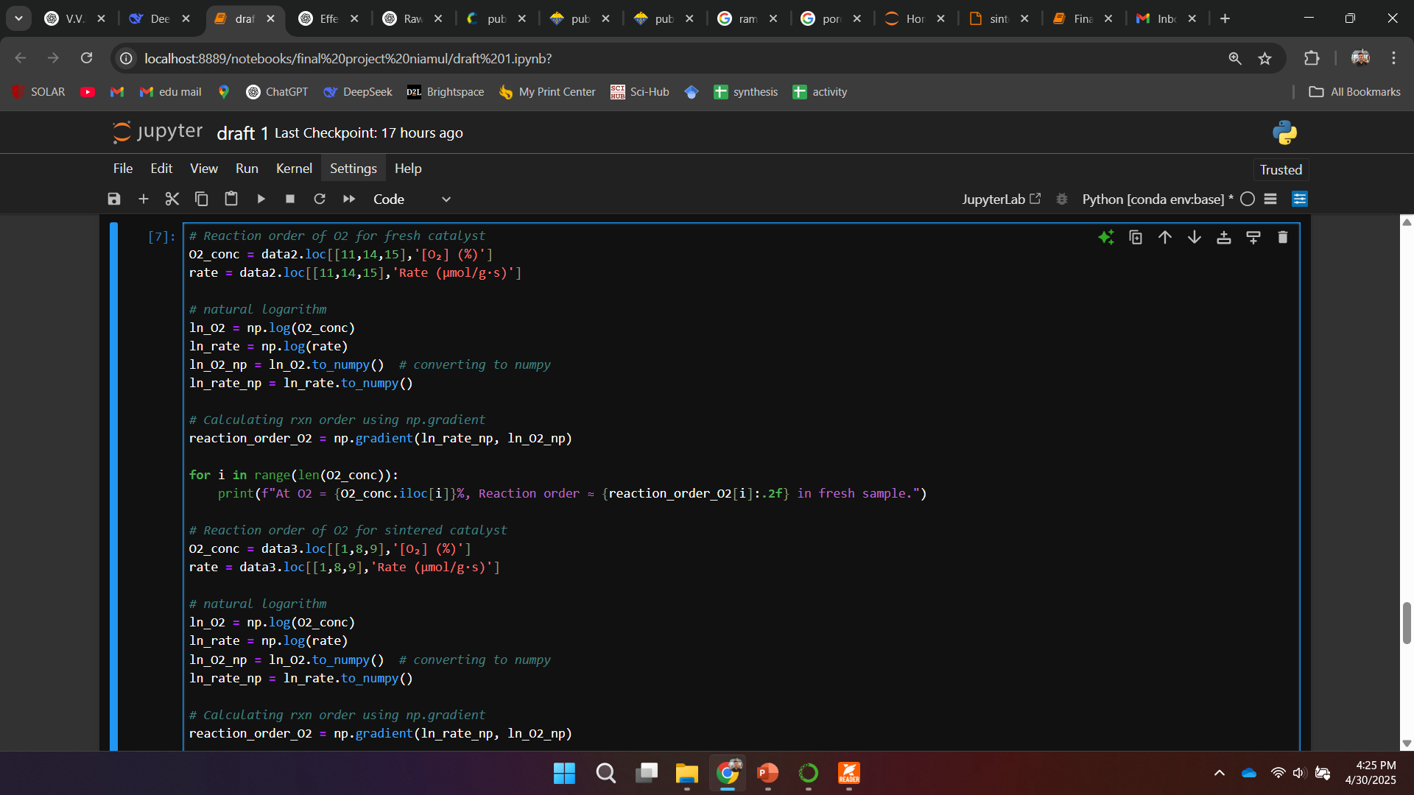
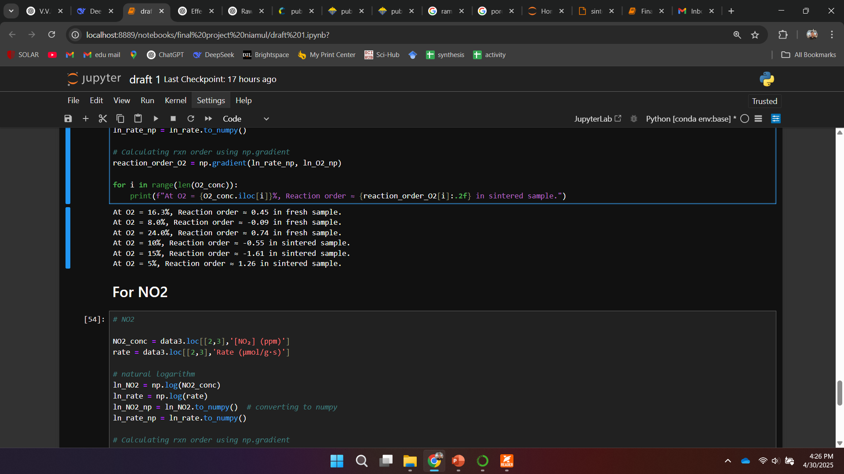
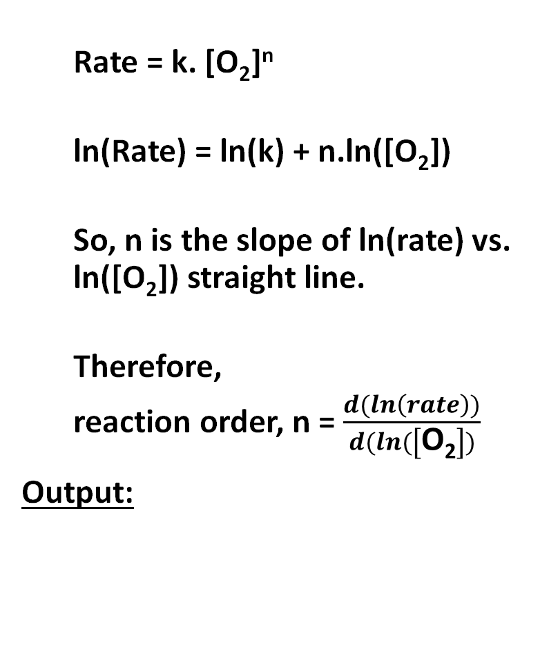
Application of Python: Reaction order
Rate = k. [O₂]^{n}
ln(Rate) = ln(k) + n.ln([O₂])
So, n is the slope of ln(rate) vs. ln([O₂]) straight line.
Therefore,
reaction order, n = $\frac{d(ln\left(rate\right))}{d(ln(\left[\text{O}\text{2}\right])}$
Output:
Reaction order of O₂ for fresh and sintered samples.

Slide 16
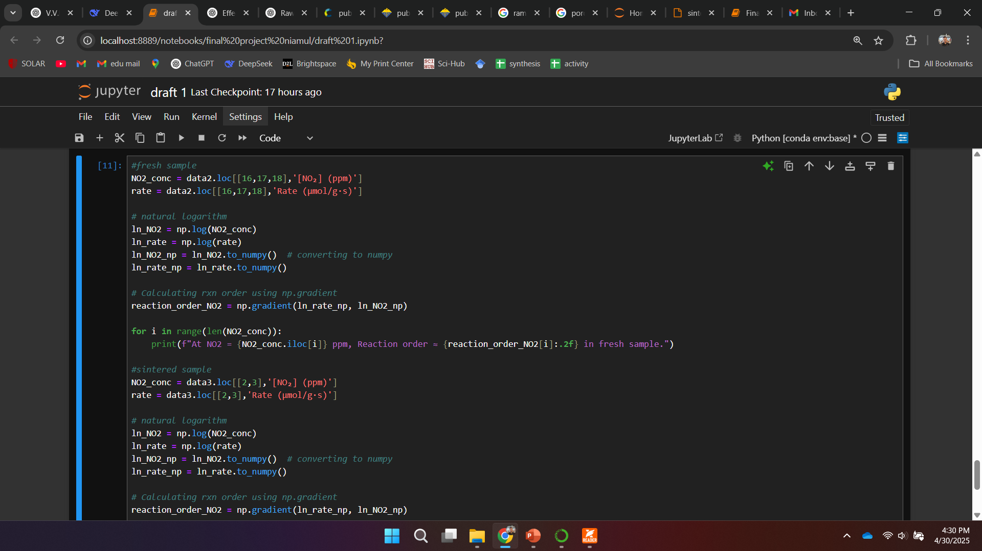
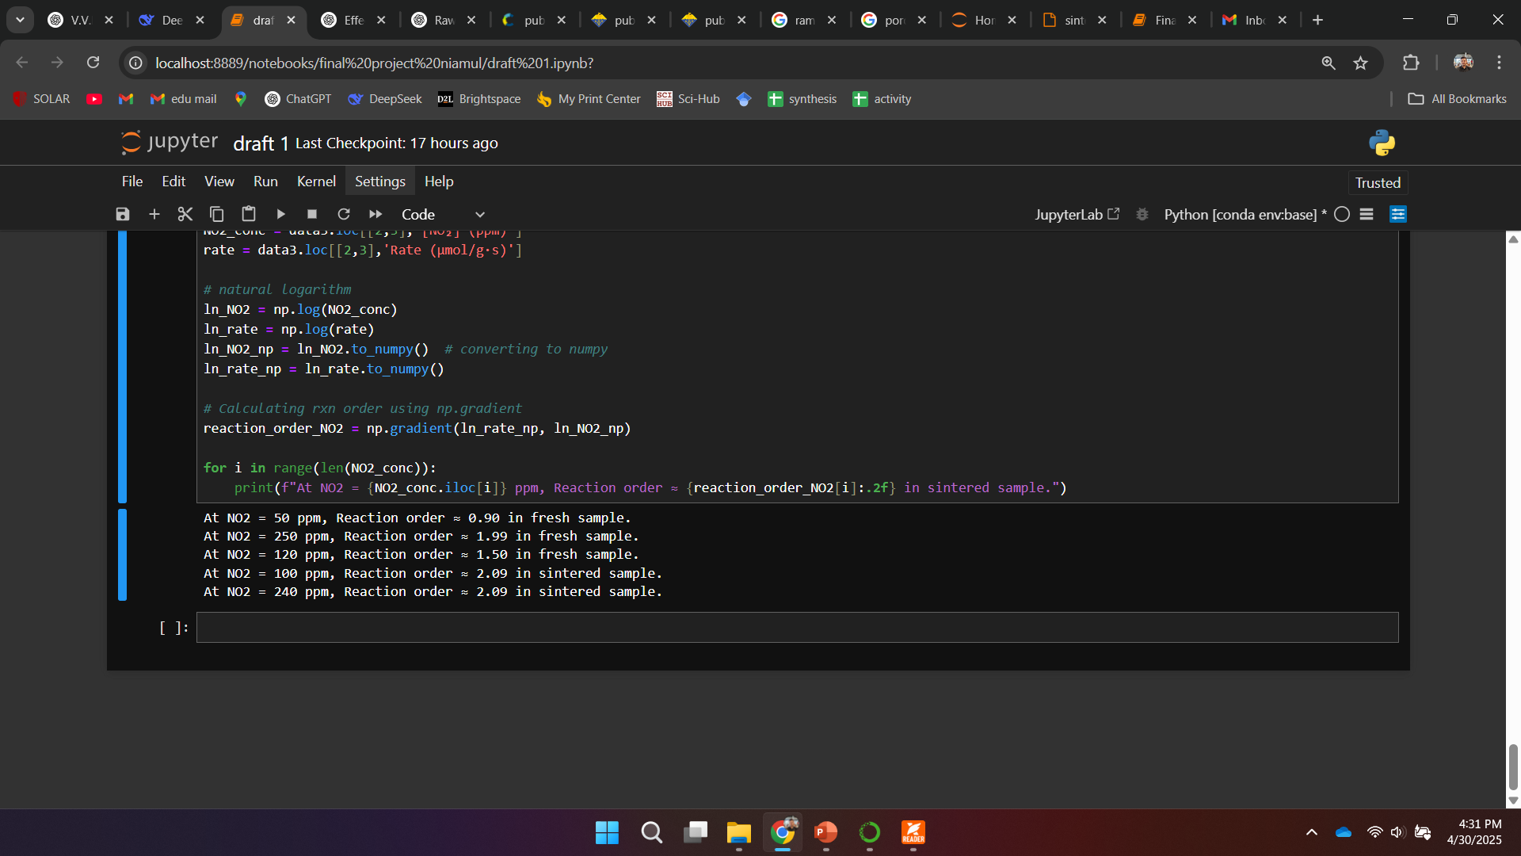
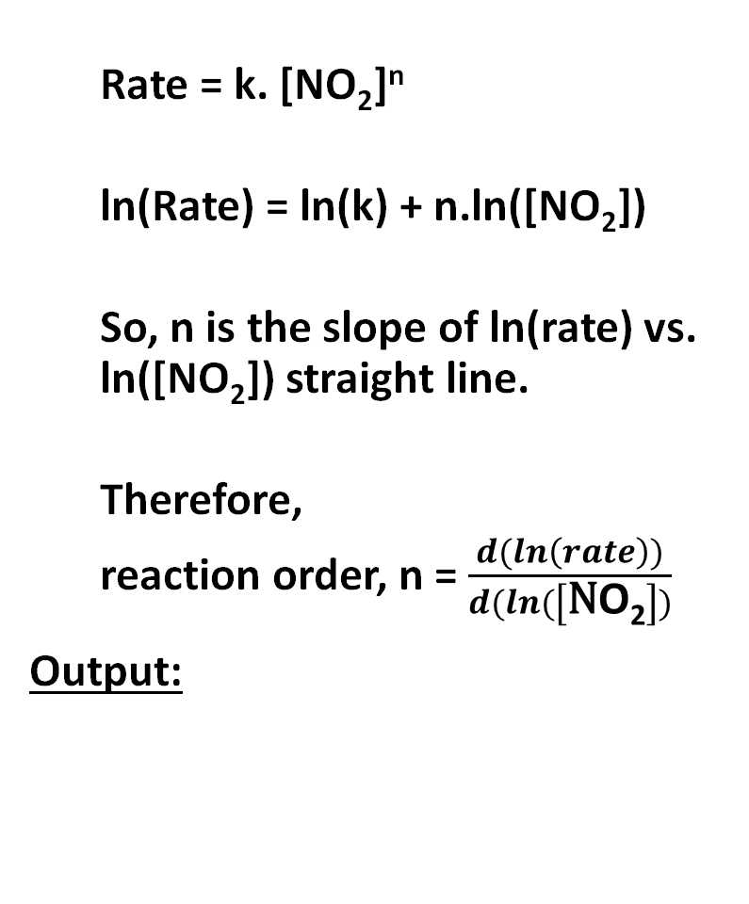
Application of Python: Reaction order
Rate = k. [NO₂]^{n}
ln(Rate) = ln(k) + n.ln([NO₂])
So, n is the slope of ln(rate) vs. ln([NO₂]) straight line.
Therefore,
reaction order, n = $\frac{d(ln\left(rate\right))}{d(ln(\left[\text{N}\text{O}\text{2}\right])}$
Output:
Reaction order of NO₂ for fresh and sintered samples.

Slide 17
References
S.S. Mulla et al. / Journal of Catalysis 241 (2006) 389–399
U.S. Environmental Protection Agency (.gov) https://cfpub.epa.gov › roe

